Slide 1
Chongqing University of Technology
ATAI
Advanced Technique of Artificial Intelligence
Chongqing University of Technology
Improving Pair-wise Aspect and Opinion Terms Extraction with Rich Syntactic Knowledge
(IJCAI-2021)
code: https://github.com/ChocoWu/Synfue-PAOTE
Reported by Ling Zhu

Slide 2
Chongqing University of Technology
ATAI
Advanced Technique of Artificial Intelligence
Chongqing University of Technology
Introduction
Motivation
Approach
Experiments
Conclusion

Slide 3
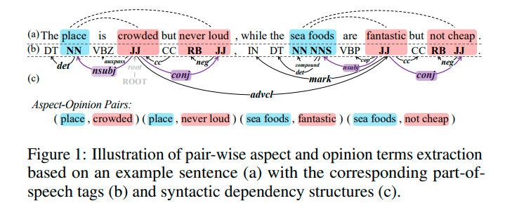
Introduction

Slide 4
Motivation
1. The latest work is based on joint learning methods for better task performance, without considering the syntactic information of the sentence.
2. Without considering the syntactic dependency label features.
3. The linguistic part-of-speech (POS) tag features are an overlooked potential performance enhancer, Intuitively, POS tags entail the boundary information between neighbors of spans, which can essentially promote the recognition of aspect and opinion terms.

Slide 5
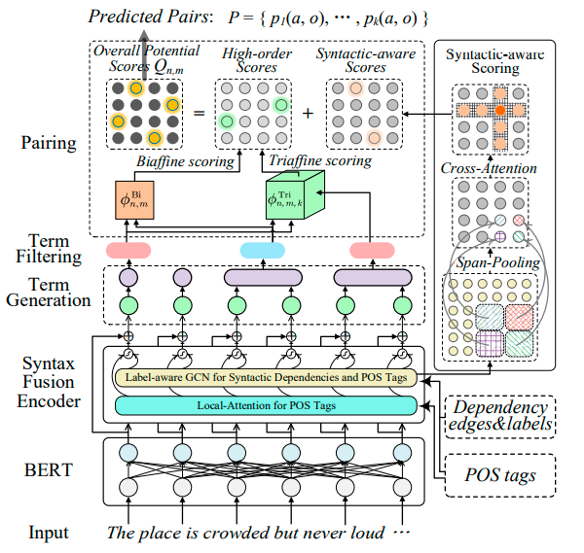
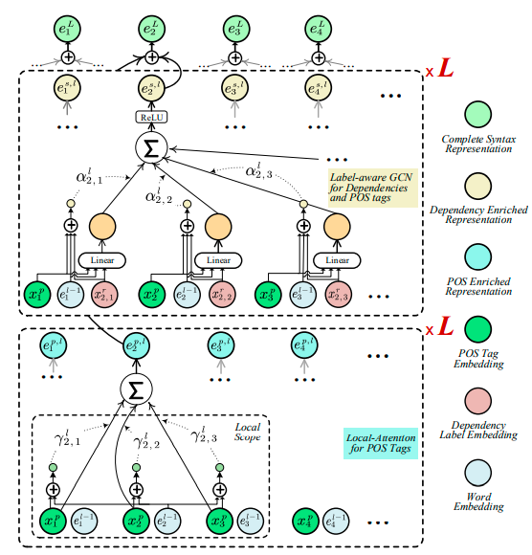
Approach
Notes:
Grid Tagging Schema
2020-EMNLP-Grid Tagging Scheme for Aspect-oriented Fine-grained Opinion Extraction

Slide 6
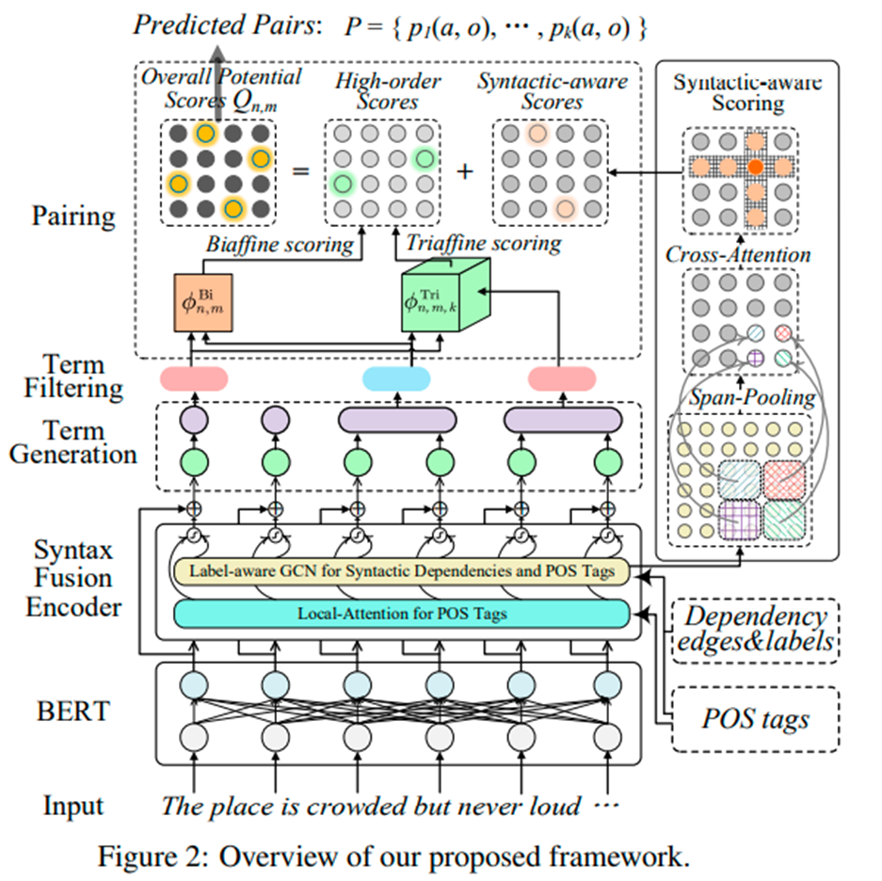
Approach

Slide 7
Approach
Local-attention for encoding POS tags
At the l-th layer, the local attention operation is performed at a scope of d window size:
for each word $w_{t}$in s, we mark its corresponding POS tag as $w_{t}^{p}$, and obtain its POS embedding $x_{t}^{p}$.

Slide 8
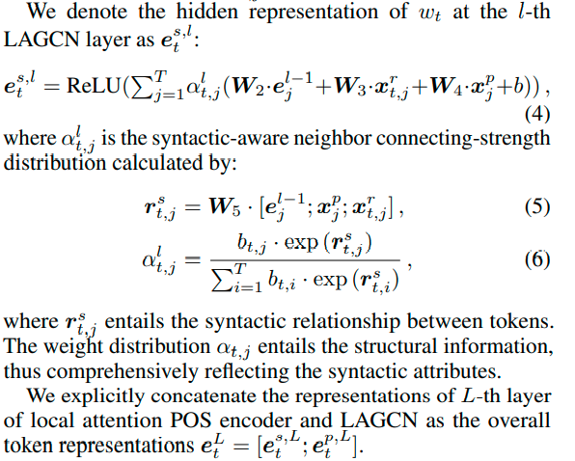
Approach
Label-aware GCN for rich syntactic features
dependency label embedding
is dependency edges
Notes:
dependency label embedding

Slide 9
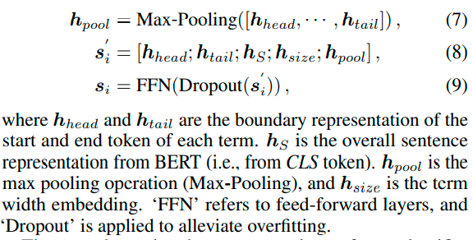
Approach
Term Generation and Filtering
Aspect, opinion, invalid
Notes:
Aspect,opinion,invalid

Slide 10
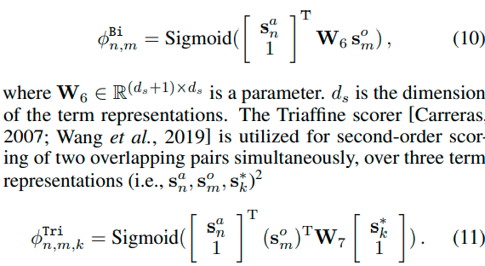
Approach
Term Pairing
aspect term
opinion term
High-order scoring.
Biaffine scorer measure the dyadic relations between each pair only models the dyadic relations between each pair, which may lead to an insufficient exploration of the triadic relations that occur in the overlapping aspect-opinion pair structures.
Notes:
Aspect term opinion term

Slide 11
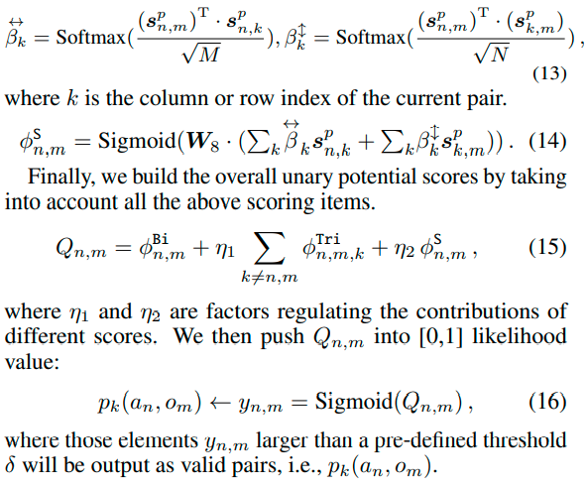
Approach
Syntactic-aware scoring

Slide 12
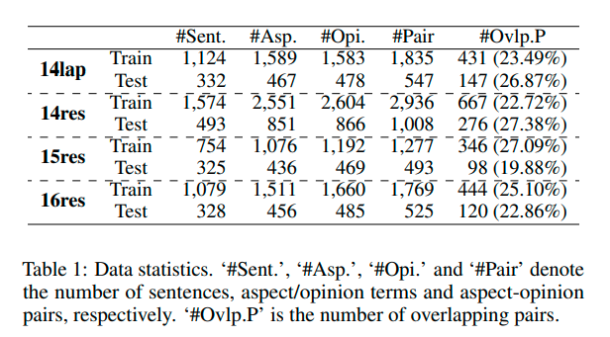
Experiments

Slide 13
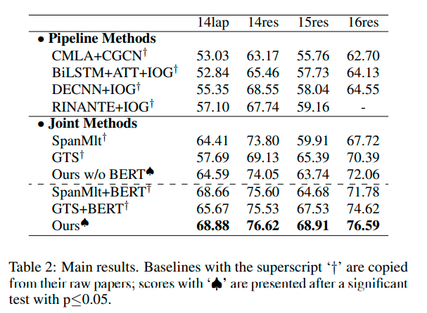
Experiments

Slide 14
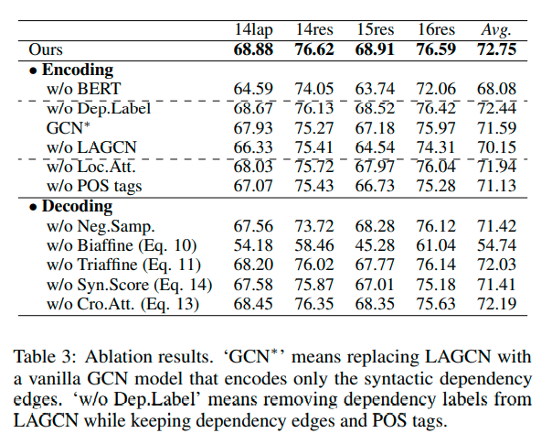
Experiments

Slide 15
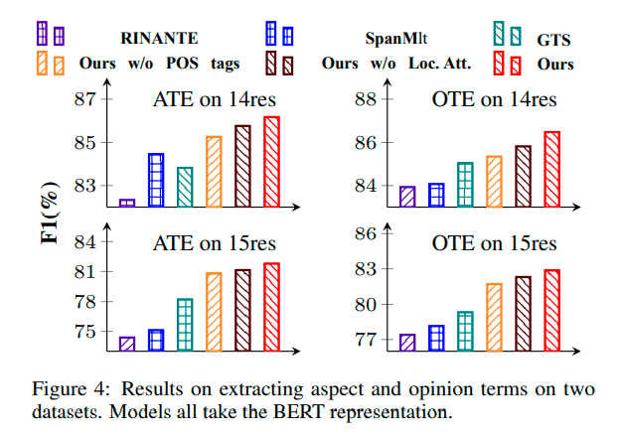
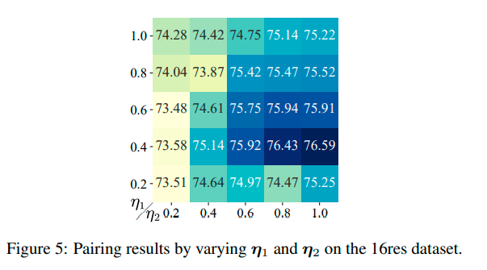
Experiments

Slide 16
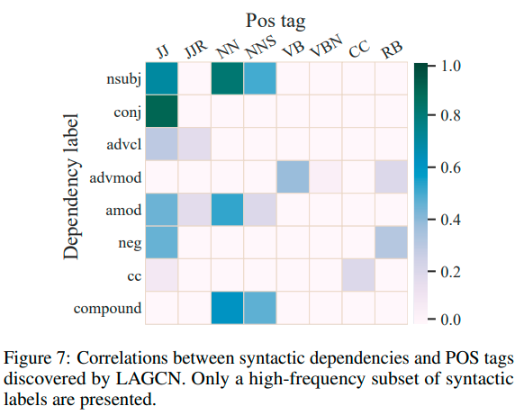
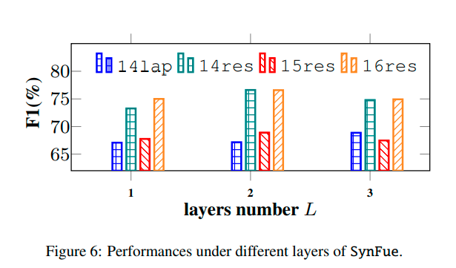
Experiments

Slide 17
Thanks

